Slide 1
How does the web work
When you type a web address into your browser (for our analogy that's like walking to the shop):
The browser goes to the DNS server, and finds the real address of the server that the website lives on (you find the address of the shop).
The browser sends an HTTP request message to the server, asking it to send a copy of the website to the client (you go to the shop and order your goods). This message, and all other data sent between the client and the server, is sent across your internet connection using TCP/IP.
If the server approves the client's request, the server sends the client a "200 OK" message, which means "Of course you can look at that website! Here it is", and then starts sending the website's files to the browser as a series of small chunks called data packets (the shop gives you your goods, and you bring them back to your house).
The browser assembles the small chunks into a complete web page and displays it to you (the goods arrive at your door — new shiny stuff, awesome!).

Slide 2
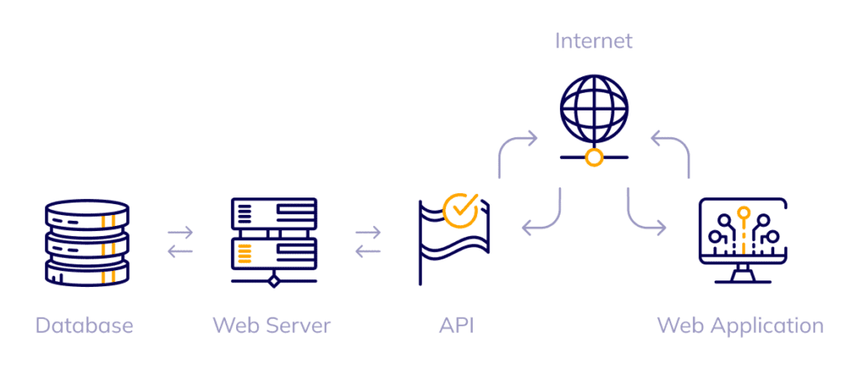
We can summarize it in this pattern :

Slide 3
To be a web devoloper you need to learn :
.
Html : (for HyperText Markup Language, which can be translated into “hypertext markup language”) is the language used to structure a web page and its content. For example, we can organize the content into a set of paragraphs, a list of elements, use images or data tables.
Css : is a styling language that allows users to create, design and style various web pages. SCSS is a special file type in a SASS program that must be written in the Ruby language. Languages ​​used. We generally use CSS in JavaScript and HTML. We generally use SCSS in the Ruby language
Javascript : is a programming language used by developers to design interactive websites. JavaScript features can help improve a website's user experience, from updating social media feeds to displaying animations and interactive maps

Slide 4
Well i chose web developmet fo many reasons :
First : from my childhood i was very interested with technology and i wanted to learn more and Web development is a field that allows you to create digital experiences and interact with the latest technologies.
Second : I think web development is a high-demand field with numerous job opportunities and it is a well paied as well .
Third : web development is a good way to express my creativity through designing and building the web and choosing the color palette

